Slide 1

A
Containers Secure
Supply Chain (CSSC)
Framework

Slide 2
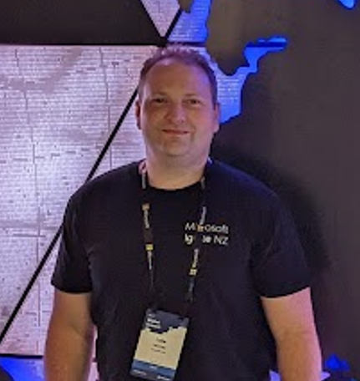


Hello!
Thank you for joining us today
Speaker: Luke Murray
Microsoft Learn Expert and Microsoft Azure MVP, and Senior Consultant from Hamilton, New Zealand.
https://x.com/lukemurraynz
https://www.linkedin.com/in/ljmurray/
https://luke.geek.nz/

Slide 3
Container Supply Chain (CSSC) Framework
Acquire
Catalog
Build
Deploy
Run
Authenticity & Integrity
Observability

Slide 4
Acquire
Catalog
Build
Deploy
Run
Acquire
Authenticity & Integrity
Observability

Slide 5
Acquire
Catalog
Build
Deploy
Run
Catalog
Authenticity & Integrity
Observability

Slide 6
Acquire
Catalog
Build
Deploy
Run
Build
Authenticity & Integrity
Observability

Slide 7
Acquire
Catalog
Build
Deploy
Run
Deploy
Authenticity & Integrity
Observability

Slide 8
Acquire
Catalog
Build
Deploy
Run
Run
Authenticity & Integrity
Observability

Slide 9

Quarantine
Catalog
Deploy
Azure Container Registries

Slide 10
